Slide 1
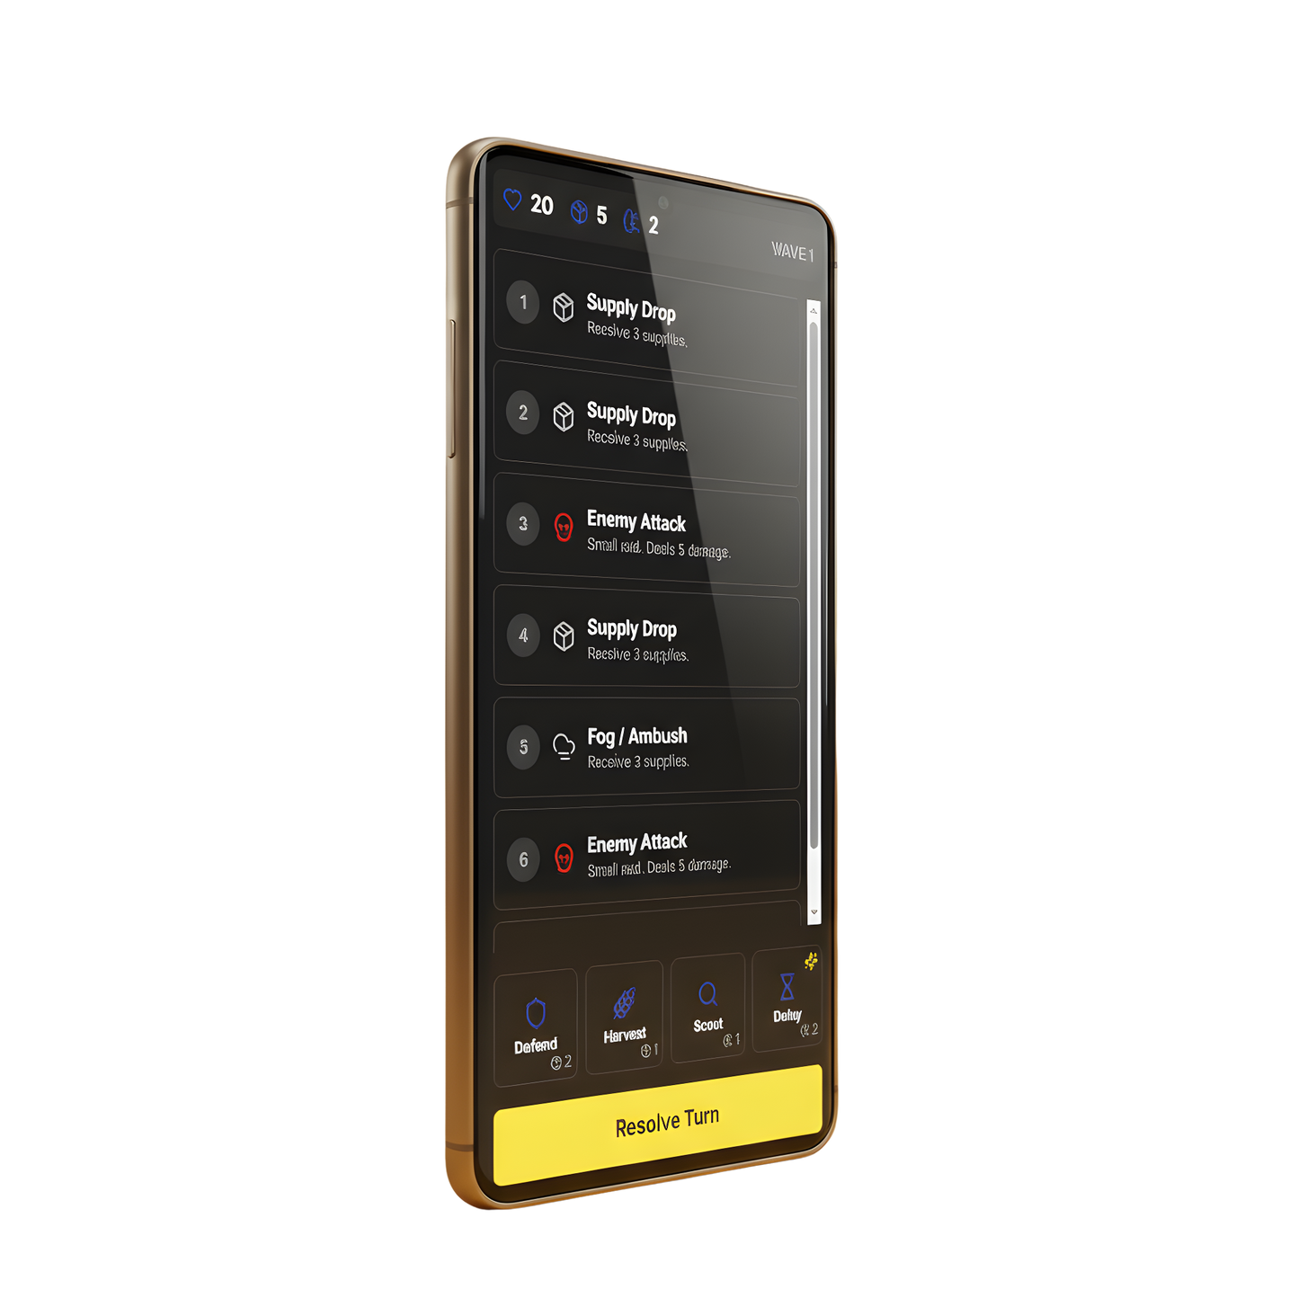
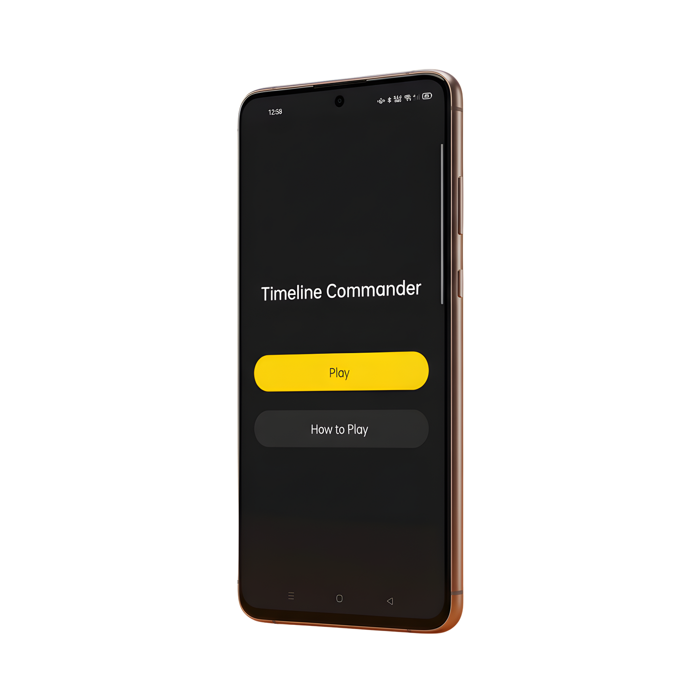
CHROMM
CHROMM
CHROMM

Slide 2
CHROMM
CHROMM
CHROMM
Chromm

Slide 3
CHROMM
CHROMM
CHROMM
Chromm

Slide 4
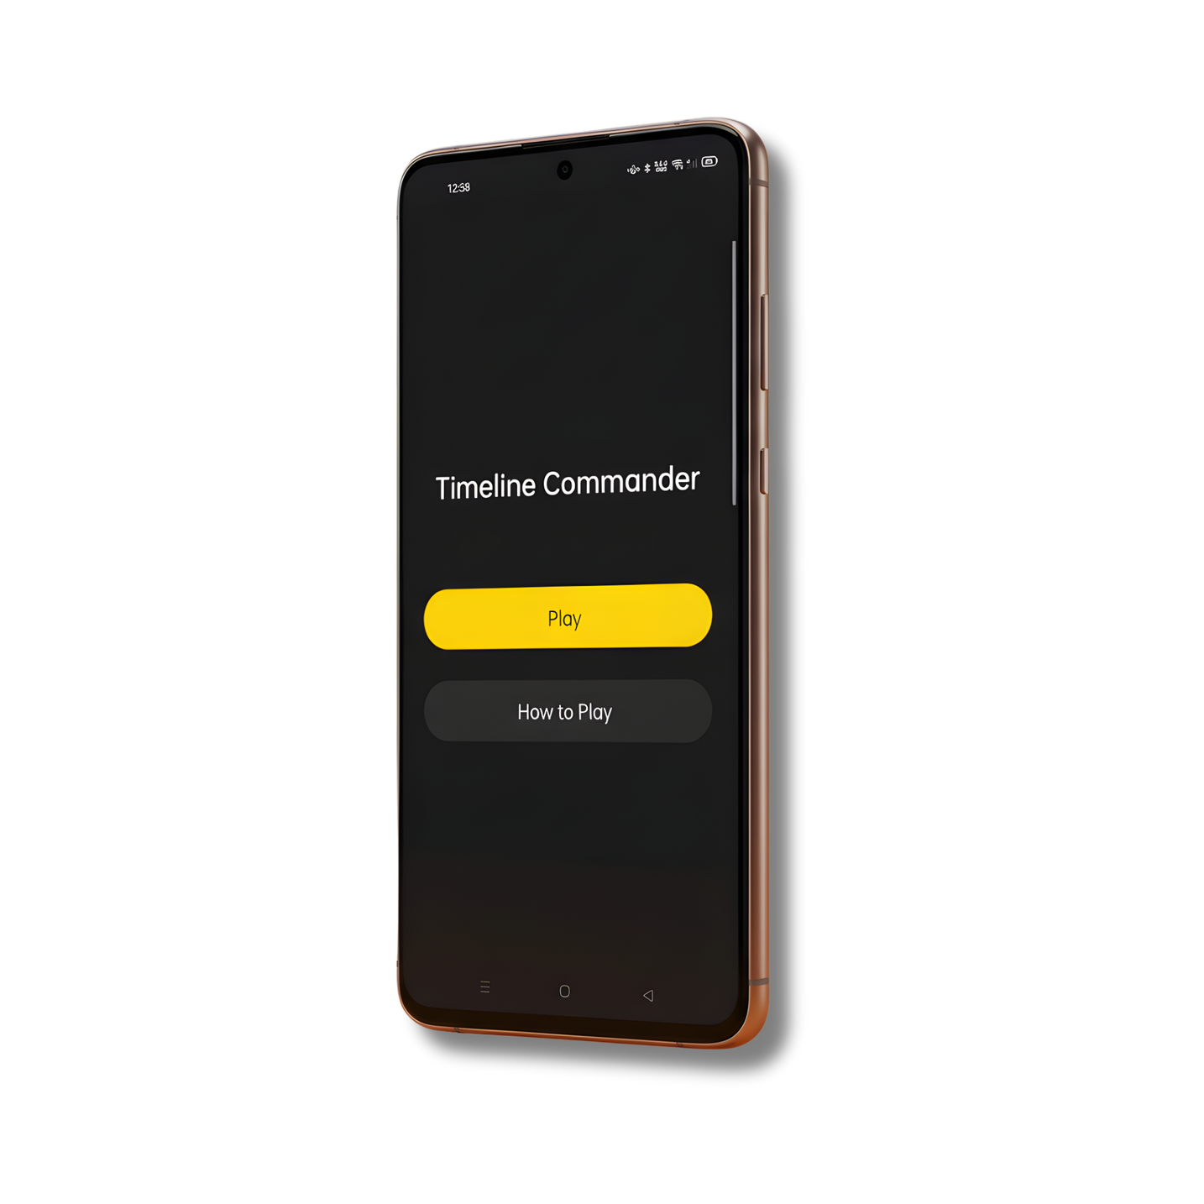
Chromm
A Timeline-Driven RTS Strategy Game
A mobile strategy experience where you see the future and plan your survival.
INTERFACE
INTERFACE
INTERFACE
INTERFACE

Slide 5
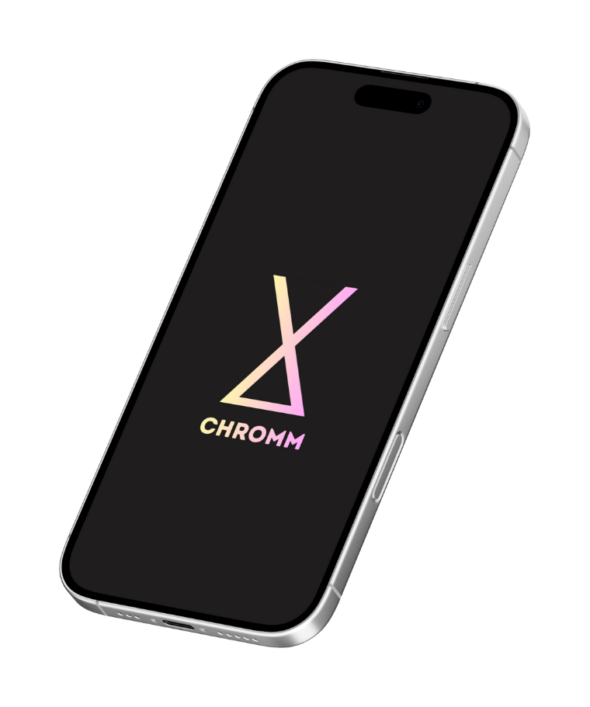
Chromm
A Timeline-Driven RTS Strategy Game
A mobile strategy experience where you see the future and plan your survival.
INTERFACE
INTERFACE
Chromm
INTERFACE
Chronicle Commander is a portrait‑mode Android strategy game where you read a visible timeline of future events and drag limited order cards onto specific turns to survive increasingly difficult waves. Each run challenges you to manage HP, Supplies, and Intel while choosing when to defend, scout, manipulate time, or invest in economy and healing, with both a classic single‑lane mode and an RTS‑style dual‑lane difficulty that keeps decisions fast, tactical, and readable in a one‑hand mobile UI.
INTERFACE

Slide 6
OBJECTIVES
INTERFACE
INTERFACE
Chromm
INTERFACE
Chronicle Commander is a portrait‑mode Android strategy game where you read a visible timeline of future events and drag limited order cards onto specific turns to survive increasingly difficult waves. Each run challenges you to manage HP, Supplies, and Intel while choosing when to defend, scout, manipulate time, or invest in economy and healing, with both a classic single‑lane mode and an RTS‑style dual‑lane difficulty that keeps decisions fast, tactical, and readable in a one‑hand mobile UI.
INTERFACE

Slide 7
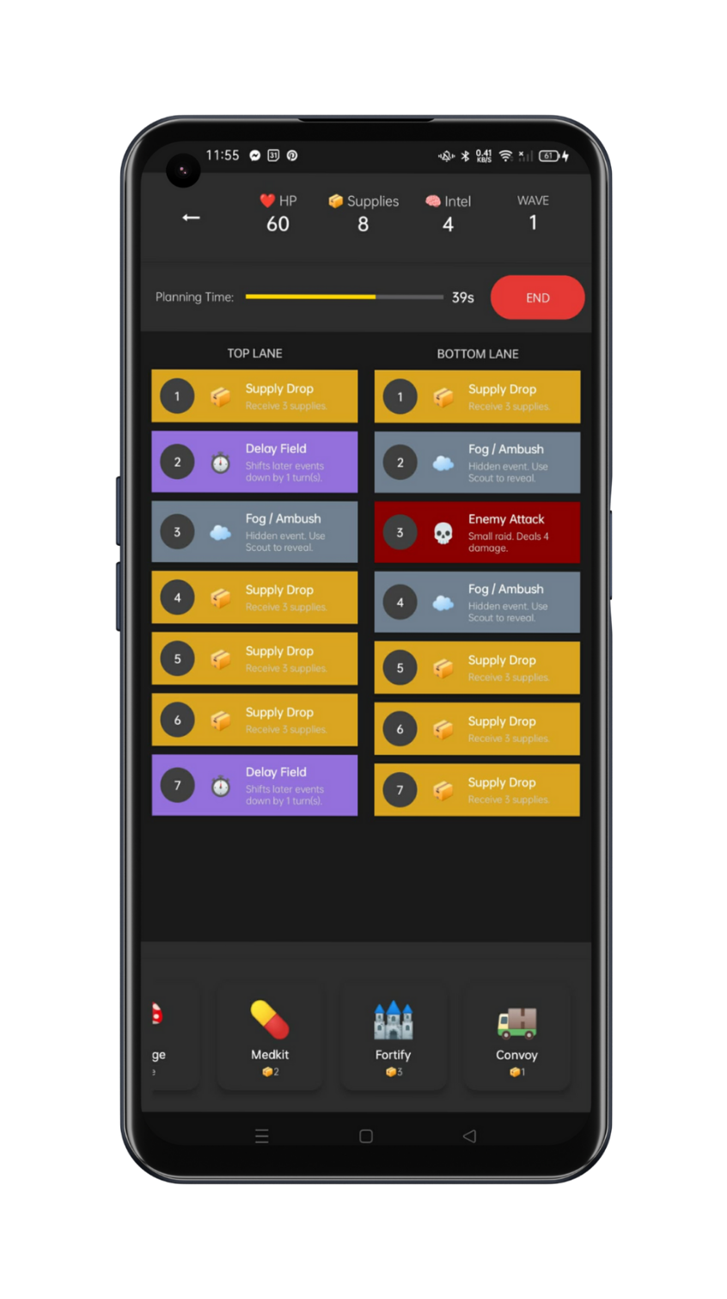
OBJECTIVE
OBJECTIVE
OBJECTIVES
Create a survival-based game loop with real-time decision pressure
Design meaningful resource management (HP, Supplies, Intel)
Implement innovative RTS features (dual lanes, planning timers, commander powers)
Build a polished, one-handed mobile experience
Unlock progression through surviving waves and difficulty tiers
OBJECTIVE

Slide 8
WHAT WE
BUILT
MINIMAL
MINIMAL
MINIMAL
MINIMAL
OBJECTIVE
OBJECTIVE
Create a survival-based game loop with real-time decision pressure
Design meaningful resource management (HP, Supplies, Intel)
Implement innovative RTS features (dual lanes, planning timers, commander powers)
Build a polished, one-handed mobile experience
Unlock progression through surviving waves and difficulty tiers
OBJECTIVE

Slide 9




EVENT CARDS
01
Supply drop
Receive 5 supplies
02
Fog / Ambush
Prepare
03
Enemy Attack
Small raid, Deals 5 damage
04
Delay Field
MINIMAL
WHAT WE
BUILT
MINIMAL
MINIMAL
MINIMAL
OBJECTIVE
OBJECTIVE
Create a survival-based game loop with real-time decision pressure
Design meaningful resource management (HP, Supplies, Intel)
Implement innovative RTS features (dual lanes, planning timers, commander powers)
Build a polished, one-handed mobile experience
Unlock progression through surviving waves and difficulty tiers
OBJECTIVE

Slide 10







EVENT CARDS
ORDER CARDS
50
10
01
Supply drop
5
Receive 5 supplies
02
Fog / Ambush
Prepare
DEFENSE
HARVEST
03
Enemy Attack
Small raid, Deals 5 damage
SCOUT
DELAY
04
Delay Field
WHAT WE
BUILT
MINIMAL
MINIMAL
MINIMAL
MINIMAL

Slide 11



EVENT CARDS
ORDER CARDS
TURN
50
10
01
Supply drop
5
Receive 5 supplies
02
Fog / Ambush
Prepare
DEFENSE
HARVEST
03
Enemy Attack
Small raid, Deals 5 damage
SCOUT
DELAY
04
Delay Field

Slide 12
ORDER CARDS
TURN
50
15
01
Supply drop
5
Receive 5 supplies
02
Fog / Ambush
Prepare
DEFENSE
HARVEST
03
Enemy Attack
Small raid, Deals 5 damage
SCOUT
DELAY
04
Delay Field

Slide 13
TURN
50
10
01
Supply drop
4
Receive 5 supplies
02
Fog / Ambush
Prepare
DEFENSE
HARVEST
03
Enemy Attack
Small raid, Deals 5 damage
SCOUT
DELAY

Slide 14
TURN
45
10
01
Supply drop
5
Receive 5 supplies
02
Fog / Ambush
Prepare
DEFENSE
HARVEST
03
Enemy Attack
Small raid, Deals 5 damage
SCOUT
DELAY

Slide 15
TURN
45
10
01
Supply drop
5
Receive 5 supplies
02
Fog / Ambush
Prepare
DEFENSE
HARVEST
03
Enemy Attack
Small raid, Deals 5 damage
SCOUT
DELAY

Slide 16
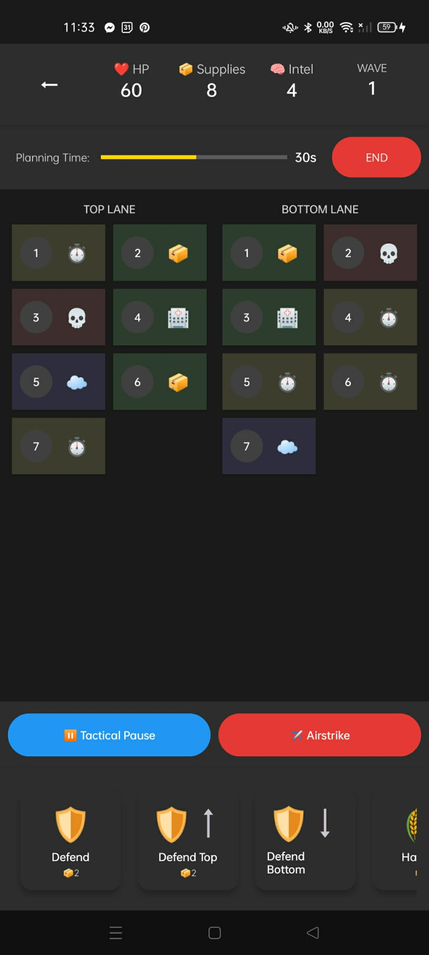
CHALLENGES
& SOLUTION
CHALLENGES
CHALLENGES
CHALLENGES
CHALLENGES
CHALLENGES
CHALLENGES
CHALLENGES
Clarity: Making RTS lanes understandable at a glance
Real-time pressure: Balancing difficulty with usability
Content overflow: Too many events/cards on small screen

Slide 17
CHALLENGES
CHALLENGES
CHALLENGES
CHALLENGES
CHALLENGES
CHALLENGES
Clarity: Making RTS lanes understandable at a glance
Real-time pressure: Balancing difficulty with usability
Content overflow: Too many events/cards on small screen
CHALLENGES
SOLUTION
SOLUTION
SOLUTION
SOLUTION

Slide 18
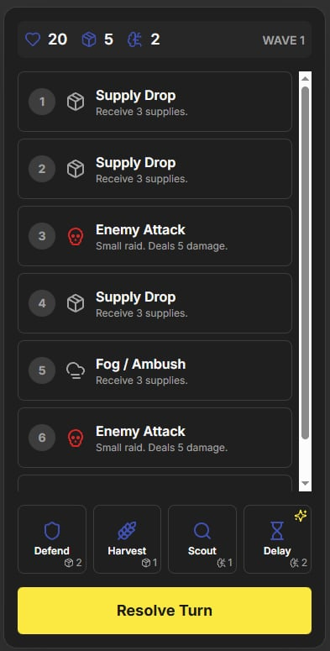
CHALLENGES
CHALLENGES
CHALLENGES
CHALLENGES
CHALLENGES
Clarity: Making RTS lanes understandable at a glance
Real-time pressure: Balancing difficulty with usability
Content overflow: Too many events/cards on small screen
SOLUTION
MINIMAL
SOLUTION
SOLUTIONS
MINIMAL
SOLUTION
SOLUTION
Minimalism: 7-slot timeline, limit visible orders
Adjustable timer: Plan-time tuning per difficulty
Label & color: Each lane, each event clearly marked

Slide 19
SOLUTION
SOLUTION
SOLUTION
SOLUTION
MINIMAL
SOLUTIONS
MINIMAL
Minimalism: 7-slot timeline, limit visible orders
Adjustable timer: Plan-time tuning per difficulty
Label & color: Each lane, each event clearly marked

Slide 20
CONCLUSION
OUR
AND NEXT STEPS
CHROMM delivers a tight, innovative strategy experience grounded in a core fantasy: see the future, plan your moves, survive the chaos.
Next: Playtesting, balance refinement, mobile build optimization, and potential online leaderboards.

